Slide 1
Fundamentals of OOP

Slide 2
Software Evolution
1,0
Machine Language
Assembly Language
Procedure - Oriented
Object Oriented Programming

Slide 3
Procedural Programming
Emphasis is on doing things (algorithms).
Large programs are divided into smaller programs known as functions.
Most of the functions share global data.
Data move openly around the system from function to function.
Functions transform data from one form to another.
Employs top-down approach in program design
Main Program
Function-1
Function-2
Function-3
Function-4
Function-5
Function-6
Function-7
Function-8

Slide 4
Object Oriented Programming
Object Oriented Programming is basically considered as design methodology for creating a non-rigid application
In OOPS every logic is written to get our work done, but this is done based on entity which we call it as Objects
OOP allow us to decompose our problem in to small unit of work which are accessed via Objects.
We build function around this objects.
Emphasis is on data rather than procedure.
Data structures are designed such that they characterize the objects.
Functions that operate on the data of an object are ties together in the data structure.
Data is hidden and cannot be accessed by external function.
Objects may communicate with each other through function.
New data and functions can be easily added whenever necessary.
Follows bottom up approach in program design.
Object A
Object B
Data
Data
Function
Function
Object C
Data
Function
Notes:
Fundamentals of OOP: Class, Object, Data Abstraction, Data Encapsulation, Inheritance, Polymorphism.
Classes and Objects: Creation, Accessing Class Members, Access Specifiers, Member Function Definition, Inline Function, Static Data Members, Function Overloading, Constructor and Destructor, Objects and Memory Requirements, Friend Functions.

Slide 5
Features of OOP
Programming language with OOP support has to fulfill these features
Abstraction
Encapsulation
Inheritance
Polymorphism

Slide 6



Real life Example
Mobile as an object was designed to provide basic functionality as
Calling and Receiving calls
Messaging
Thousands of new features and models are getting added
Mobile
iPhone
Samsung
Nokia

Slide 7
Objects
Any real world entity which can have some characteristics or which can perform some work is called as Object.
This object is also called as an instance i.e. - a copy of an entity in programming language.
A mobile manufacturing company, at a time manufactures lacs of pieces of each model which are actually an instance.
These objects are differentiated from each other via some identity (e.g. IMEI number) or its characteristics.
Mobile mbl1 = new Mobile ();
Mobile mbl2 = new Mobile ();

Slide 8


Class
class Mobile
{
private:
string IMEICode;
string SIMCard;
string Processor;
int InternalMemory;
bool IsSingleSIM;
public:
void GetIMEICode()
{
cout << "IMEI Code - IEDF34343435235";
}
void Dial()
{
cout << "Dial a number";
}
void Receive()
{
cout << "Receive a call";
}
virtual void SendMessage()
{
cout << "Message Sent";
}
}
A Class is a plan which describes the object.
We call it as a blue print of how the object should be represented.
Mainly a class would consist of a name, attributes & operations.
A Mobile can be a class which has some attributes like Profile Type, IMEI Number, Processor, and some more.) & operations like Dial, Receive & SendMessage.
Mobile
Class
Properties
Processor
IMEICode
IsSingleSIM
Methods
Dial
Receive
SendMessage
GetWifiConnection
ConnectBlueTooth
GetIMEICode

Slide 9
Abstraction
Abstraction - only show relevant details and rest all hide it
its most important pillar in OOPS as it is providing us the technique to hide irrelevant details from User
Dialing a number calls some method internally which concatenate the numbers and displays it on screen but what is it doing we don’t know.
Clicking on green button actual send signals to calling person’s mobile but we are unaware of how it is doing.
void Dial()
{
//Write the logic
cout << "Dial a number";
}

Slide 10
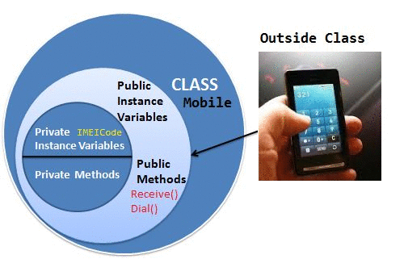
Encapsulation
Encapsulation is defined as the process of enclosing one or more details from outside world through access right.
It says how much access should be given to particular details.
Both Abstraction & Encapsulation works hand in hand because Abstraction says what details to be made visible & Encapsulation provides the level of access right to that visible details. i.e. – It implements the desired level of abstraction.
When we switch on the Bluetooth I am able to connect another mobile but not able to access the other mobile features like dialing a number, accessing inbox etc. This is because, Bluetooth feature is given some level of abstraction.
This is handled by access specifier like public, private, protected, and internal
private:
string IMEICode = "76567556757656";

Slide 11
Polymorphism
class Samsumg :public Mobile
{
public:
void GetWIFIConnection()
{
cout<<"WIFI connected";
}
//This is one method which shows camera functionality
void CameraClick()
{
cout<<“Camera clicked";
}
//This is one overloaded method which shows camera functionality as well but with its camera's different mode(panaroma)
void CameraClick(string CameraMode)
{
cout<<"Camera clicked in " + CameraMode + " Mode";
}
}
Polymorphism can be defined as the ability of doing the same operation but with different type of input.
More precisely we say it as ‘many forms of single entity’
Static or Compile time polymorphism
Mobile have 5MP camera available i.e. – it is having a functionality of CameraClick(). Now same mobile is having Panorama mode available in camera, so functionality would be same but with additional mode. This type is said to be Static polymorphism or Compile time polymorphism.
Compile time polymorphism the compiler knows which overloaded method it is going to call.
Compiler checks the type and number of parameters passed to the method and decides which method to call and it will give an error if there are no methods that matches the method signature of the method that is called at compile time.

Slide 12
Polymorphism
Dynamic polymorphism or Runtime polymorphism
SendMessage was intended to send message to single person at a time but suppose Nokia had given provision for sending message to a group at once. i.e. - Overriding the functionality to send message to a group.
For overriding you need to set the method, which can be overridden to virtual & its new implementation should be decorated with override keyword.
By runtime polymorphism, we can point to any derived class from the object of the base class at runtime that shows the ability of runtime binding.
class Nokia : public Mobile
{
public :
void GetBlueToothConnection()
{
cout<<"Bluetooth connected";
}
//New implementation for this method which was available in Mobile Class
//This is runtime polymorphism
override void SendMessage()
{
cout<<"Message Sent to a group";
}
}

Slide 13
Inheritance
Ability to extend the functionality from base entity to new entity belonging to same group.
This will help us to reuse the functionality which is defined before.
Basic Mobile functionality is to Send Message, dial & receive call.
Mobile brands are using this basic functionality by extending the mobile class functionality and adding their own new features to their respective brand.
There are mainly 4 types of inheritance:
Single level inheritance
Multi-level inheritance
Hierarchical inheritance
Hybrid inheritance
Multiple inheritance
Mobile
iPhone
Samsung
Nokia
iPhone 5
iPhone 6
iPhone X
Samsung S4
Samsung S5
Nokia Lumia 625

Slide 14
Inheritance
Single level inheritance
Single base class & a single derived class i.e. - A base mobile features are extended by Samsung brand.
Multi level inheritance
In Multilevel inheritance, there is more than one single level of derivation.
E.g. After base features are extended by Samsung brand, a new model is launched with latest Android OS
Mobile
Samsung
Mobile
Samsung
Samsung S5

Slide 15
Inheritance
Hierarchical inheritance
Multiple derived class would be extended from base class
It’s similar to single level inheritance but this time along with Samsung, Nokia is also taking part in inheritance.
Hybrid inheritance
Single, Multilevel, & hierarchal inheritance all together construct a hybrid inheritance.
Mobile
Samsung
Nokia
Samsung S5
Nokia Lumia 625
Mobile
Samsung
Nokia

Slide 16
Object based Vs Oriented Language
Languages that support programming with objects are said to the objects-based programming languages
Major feature that are required for object based programming are:
Data encapsulation
Data hiding and access mechanisms
Automatic initialization and clear-up of objects
Operator overloading
Object-oriented programming language incorporates two additional features, namely, inheritance and dynamic binding
Object-based features + inheritance + dynamic binding

Slide 17
Application of OOP
Real-business system are often complex and contain many objects with complicated attributes and methods.
Some of the areas of application of OOPs are:
Real-time system
Simulation and modeling
Object-oriented data bases
Hypertext, Hypermedia, and expertext
AI and expert systems
Neural networks and parallel programming
Decision support and office automation systems
CIM/CAM/CAD systems

Slide 18
Why C++ ?
C++ is a versatile language for handling very large programs including editors, compilers, databases, communication systems and any complex real life applications systems
C++ allows create hierarchy related objects to build special object-oriented libraries which can be used later by many programmers.
the C part of C++ gives the language the ability to get closed to the machine-level details.
C++ programs are easily maintainable and expandable - it is very easy to add to the existing structure of an object.
It is expected that C++ will replace C as a general-purpose language in the near future.

Slide 19
Basics of c++

Slide 20
Simple C++ Program
// Simple C++ program to display "Hello World"
// Header file for input output functions
#include<iostream>
using namespace std;
// main function - where the execution of program begins
int main()
{
// prints hello world
cout<<"Hello World";
return 0;
}
instructs the compiler to include the contents of the file enclosed
within angular brackets into the source file.
defines a scope for the identifiers that are used in a program
every main() returns an integer value to operating system
and therefore it should end with return (0) statement
Notes:
Classes are generally declared using the keyword class, with the following statement
The body of the declaration can contain members that can be either data or function declaration, and optionally access specifier.
The variable declared inside the class is known as data member and the function are known as member functions
Access specifiers are keywords in object oriented language that set the accessibility of classes, method and other member.

Slide 21
Structure of C++ Program
Typical C++ program contains four sections
It is a common practice to organize a program into three separate files
The class declarations are placed in a header file and the definitions of member functions go into another file.
The main program that uses the class is placed in a third file which “includes” the previous two files as well as any other file required
Include File
Class Declaration
Member Functions Definitions
Main Function Program
Server
Member Function
Class Definition
Main function program
Client
Notes:
This approach is based on the concept of client-server model. The class definition including the member functions constitute the server that provides services to the main program known as client. The client uses the server through the public interface of the class.

Slide 22
C/C++ Compilation and Linking
Source code file
(program.c)
Preprocessor
Expanded source code
(program.l)
Compiler
Object Code
(program.obj)
Linker
Executable file
(program.exe)
Notes:
https://www.geeksforgeeks.org/cc-preprocessors/

Slide 23
FUNCTION in C++
Function is a collection of declarations and statements
A function must be defined prior to it’s use in the program
Type name_of_the_function (argument list)
{
//body of the function
}

Slide 24
C++ Function Definition
C++ function is defined in two steps (preferably but not mandatory)
Step #1 – declare the function signature in either a header file (.h file) or before the main function of the program
Step #2 – Implement the function in either an implementation file (.cpp) or after the main function

Slide 25
The Syntactic Structure of a C++ Function
A C++ function consists of two parts
The function header, and
The function body
The function header has the following syntax
The function body is simply a C++ code enclosed between { }
<return value> <name> (<parameter list>)

Slide 26
Example of User-defined C++ Function
double computeTax(double income)
{
if (income < 5000.0) return 0.0;
double taxes = 0.07 * (income-5000.0);
return taxes;
}

Slide 27
Example of User-defined C++ Function
Function header
double computeTax(double income)
{
if (income < 5000.0) return 0.0;
double taxes = 0.07 * (income-5000.0);
return taxes;
}

Slide 28
Example of User-defined C++ Function
double computeTax(double income)
{
if (income < 5000.0) return 0.0;
double taxes = 0.07 * (income-5000.0);
return taxes;
}
Function header
Function body

Slide 29
Function Signature
The function signature is actually similar to the function header except in two aspects:
The parameters’ names may not be specified in the function signature
The function signature must be ended by a semicolon
Example
Unnamed Parameter
Semicolon
;
double computeTaxes(double) ;

Slide 30
Why Do We Need Function Signature?
For Information Hiding
If you want to create your own library and share it with your customers without letting them know the implementation details, you should declare all the function signatures in a header (.h) file and distribute the binary code of the implementation file
For Function Abstraction
By only sharing the function signatures, we have the liberty to change the implementation details from time to time to
Improve function performance
make the customers focus on the purpose of the function, not its implementation

Slide 31
Example
#include <iostream>
#include <string>
using namespace std;
// Function Signature
double getIncome(string);
double computeTaxes(double);
void printTaxes(double);
void main()
{
// Get the income;
double income = getIncome("Please enter the employee income: ");
// Compute Taxes
double taxes = computeTaxes(income);
// Print employee taxes
printTaxes(taxes);
}
double computeTaxes(double income)
{
if (income<5000) return 0.0;
return 0.07*(income-5000.0);
}
double getIncome(string prompt)
{
cout << prompt;
double income;
cin >> income;
return income;
}
void printTaxes(double taxes)
{
cout << "The taxes is $" << taxes << endl;
}

Slide 32
Default Arguments in Function
Case 1: No argument passed
Case 2: First argument passed
// C++ Program to demonstrate working of default argument
#include <iostream>
using namespace std;
void display(char = '*', int = 1);
int main()
{
cout << "No argument passed:\n";
display();
cout << "\nFirst argument passed:\n";
display('#');
cout << "\nBoth argument passed:\n";
display('$', 5);
return 0;
}
void display(char c, int n)
{
for(int i = 1; i <= n; ++i) {
cout << c;
}
cout << endl;
}
In C++ programming, you can provide default values for function parameters.
The idea behind default argument is simple. If a function is called by passing argument/s, those arguments are used by the function.
But if the argument/s are not passed while invoking a function then, the default values are used.
Default value/s are passed to argument/s in the function prototype.
void temp (int = 10, float = 8.8);
int main() {
temp();
}
void temp(int i, float f) {
… … …
}
void temp (int = 10, float = 8.8);
int main() {
temp(6);
}
void temp(int i, float f) {
… … …
}
Case 3: All arguments passed
Case 4: Second argument passed
void temp (int = 10, float = 8.8);
int main() {
temp(6, -2.3);
}
void temp(int i, float f) {
… … …
}
void temp (int = 10, float = 8.8);
int main() {
temp(3.4);
}
void temp(int i, float f) {
… … …
}
i = 3, f=8.8
Because, only the second argument cannot be passed. The parameter will be passed as the first argument.

Slide 33
Common Mistakes in DEFAULT ARGUMENTS
void add(int a, int b = 3, int c, int d = 4);

Slide 34
Reference Variables
A reference is an alias, or an alternate name to an existing
Contains the address of a variable (like a pointer)
No need to perform any dereferencing (unlike a pointer)
Must be initialized when it is declared
References acts as function formal parameters to support pass-by-reference
Any changes to reference variable inside the function are reflected outside the function
int x = 5;
int &z = x; // z is another name for x
int &y ; //Error: reference must be initialized
Notes:
https://www3.ntu.edu.sg/home/ehchua/programming/cpp/cp4_PointerReference.html

Slide 35
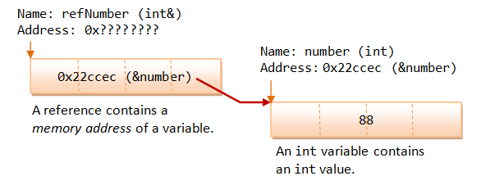
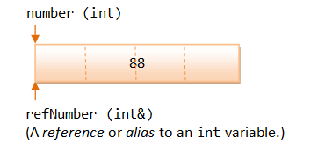
How References Work?
type &newName = existingName;
int number = 88; // Declare an int variable called number
int & refNumber = number; // Declare a reference (alias)

Slide 36
Example of Reference Parameters
#include <iostream.h>
void fun(int &y)
{
cout << y << endl;
y=y+5;
}
void main()
{
int x = 4; // Local variable
fun(x);
cout << x << endl;
}
void main()
{
int x = 4;
fun(x);
cout << x << endl;
}
1
x
?
x
4

Slide 37

Example of Reference Parameters
#include <iostream.h>
void fun(int &y)
{
cout << y << endl;
y=y+5;
}
void main()
{
int x = 4; // Local variable
fun(x);
cout << x << endl;
}
void fun( int & y )
{
cout<<y<<endl;
y=y+5;
}
3
void main()
{
int x = 4;
fun(x);
cout << x << endl;
}
x
?
x
4
2

Slide 38
Example of Reference Parameters
#include <iostream.h>
void fun(int &y)
{
cout << y << endl;
y=y+5;
}
void main()
{
int x = 4; // Local variable
fun(x);
cout << x << endl;
}
void fun( int & y )
{
cout<<y<<endl;
y=y+5;
}
4
9
void main()
{
int x = 4;
fun(x);
cout << x << endl;
}
x
?
x
4
2

Slide 39
Example of Reference Parameters
#include <iostream.h>
void fun(int &y)
{
cout << y << endl;
y=y+5;
}
void main()
{
int x = 4; // Local variable
fun(x);
cout << x << endl;
}
void fun( int & y )
{
cout<<y<<endl;
y=y+5;
}
5
void main()
{
int x = 4;
fun(x);
cout << x << endl;
}
x
?
x
9
2

Slide 40
Classes and Objects

Slide 41
Class
A way to bind data and associated function together
An expanded concept of a data structure, instead of holding only data, it can hold both data and function.
The data is to be hidden from external use.

Slide 42
Class
keyword
class class_name
{
private:
variable declaration;
public:
function declaration;
….
} ;
data member
body
member
function
access
specifiers
Notes:
Classes are generally declared using the keyword class, with the following statement
The body of the declaration can contain members that can be either data or function declaration, and optionally access specifier.
The variable declared inside the class is known as data member and the function are known as member functions
Access specifiers are keywords in object oriented language that set the accessibility of classes, method and other member.

Slide 43
Access Specifiers
Less Restrictive
Class
Accessible from own class
Accessible from derived class
Accessible from class objects
Private Area
public
No entry to
Private area
Data
Functions
protected
Accessible from own class
Accessible from derived class
Public Area
Data
Entry allowed to
Public area
Functions
private
Accessible from own class
More Restrictive
* By default all items defined in the class are private

Slide 44
Access Specifiers
Employee
Department
Manager
public:
string name;
protected:
string designation;
private:
int Age;
CommissionEmployee
SalariedEmployee

Slide 45
Access Specifiers
class Person {
public: //access control
string firstName; //these data members
string lastName; //can be accessed
tm dateOfBirth; //from anywhere
private:
string address; // can be accessed inside the class
long int insuranceNumber; //and by friend classes/functions
protected:
string phoneNumber; // can be accessed inside this class,
int salary; // by friend functions/classes and derived classes
};
Notes:
Public class members and functions can be used from outside of a class by any function or other classes.
Private class members and functions can be used only inside of class and by friend functions and classes.
Protected class members and functions can be used inside its class. Protected members and functions cannot be accessed from other classes directly. Additionally protected access specifier allows friend functions and classes to access these data members and unctions. Protected data members and functions can be used by the class derived from this class.

Slide 46
Objects
A class provides the blueprints for objects, so basically an object is created from a class.
Objects of a class are declared with exactly the same sort of declaration as variables of basic types
#include <iostream>
using namespace std;
class Box {
public:
double length; // Length of a box
double breadth; // Breadth of a box
double height; // Height of a box
};
int main() {
Box Box1; // Declare Box1 of type Box
Box Box2; // Declare Box2 of type Box
double volume = 0.0; // Store the volume of a box here
}
Class
Public data members
Objects of Box class

Slide 47
Objects
The objects of class will have their own copy of data members.
The public data members of objects of a class can be accessed using the direct member access operator (.)
int main() {
Box Box1; // Declare Box1 of type Box
Box Box2; // Declare Box2 of type Box
double volume = 0.0; // Store the volume of a box here
// box 1 specification
Box1.height = 5.0;
Box1.length = 6.0;
Box1.breadth = 7.0;
// box 2 specification
Box2.height = 10.0;
Box2.length = 12.0;
Box2.breadth = 13.0;
// volume of box 1
volume = Box1.height * Box1.length * Box1.breadth;
cout << "Volume of Box1 : " << volume <<endl;
// volume of box 2
volume = Box2.height * Box2.length * Box2.breadth;
cout << "Volume of Box2 : " << volume <<endl;
return 0;
}
Access data members
of Box1 object
Access data members
of Box2 object

Slide 48
Member Functions
"
Can be defined inside class
Or outside the class
Functions defined inside class are treated as inline functions by compiler
class Box {
public:
double length; // Length of a box
double breadth; // Breadth of a box
double height; // Height of a box
double getVolume(void) { // Returns box volume
return length * breadth * height;
}
double getSurfaceArea(void); // returns surface area
};
// member function definition
double Box::getSurfaceArea(void) {
….
}
int main() {
Box Box1;
Box1.length = 10;
Box1.height = 20;
Box1.breadth=30;
cout << “Volume of box: “ << Box1.getVolume() << endl;
cout << “Surface Area of box: “ << Box1.getSurfaceArea() << endl;
}
return_type function_name (parameters)
{
// function body
}
Inline function
return_type class_name::function_name (formal parameters)
{
// function body
}
member function declaration
member function definition
outside class
accessing member functions
Notes:
A member function of a class is a function that has its definition or its prototype within the class definition like any other variable.
It operates on any object of the class of which it is a member, and has access to all the members of a class for that object.
Member functions can be defined within the class definition (called inline) or separately using scope resolution operator, :
Class name needs to be specified before scope resolution operator
A member function will be called using a dot operator (.) on a object where it will manipulate data related to that object only

Slide 49
Arrays of Objects
Several objects of the same class can be declared as an array and used just like an array of any other data type.
The syntax for declaring and using an object array is exactly the same as it is for any other type of array.

Slide 50
Class Objects
33, Joseph
S[0]
S[1]
S[2]
S[3]
S[4]
S[5]
S[6]
S[7]
Array of Objects
ex: Student s[8];
void read_data( )
void print_data( )
St[0]
24, Sakshi
void read_data( )
void print_data( )
St[4]

Slide 51
Array of Objects
#include <iostream>
#include <string>
using namespace std;
class Student
{
string name;
int marks;
public:
void getName()
{
getline( cin, name );
}
void getMarks()
{
cin >> marks;
}
void displayInfo()
{
cout << "Name : " << name << endl;
cout << "Marks : " << marks << endl;
}
};
int main()
{
Student st[5];
for( int i=0; i<5; i++ )
{
cout << "Student " << i + 1 << endl;
cout << "Enter name" << endl;
st[i].getName();
cout << "Enter marks" << endl;
st[i].getMarks();
}
for( int i=0; i<5; i++ )
{
cout << "Student " << i + 1 << endl;
st[i].displayInfo();
}
return 0;
}
Notes:
https://www.includehelp.com/cpp-programs/cpp-class-program-to-create-class-to-read-and-add-two-times.aspx

Slide 52
Dynamic memory allocation
Dynamic memory allocation in C/C++ refers to performing memory allocation manually by programmer.
Dynamically allocated memory is allocated on Heap and non-static and local variables get memory allocated on Stack
Memory in C++ program is divided into two parts −
The stack − All variables declared inside the function will take up memory from the stack.
The heap − This is unused memory of the program and can be used to allocate the memory dynamically when program runs.
Notes:
Suppose you want to put a toy in a box, but you only have an approximate idea of its size. For that, you would require a box whose size is equal to the approximate size of the toy.
We face a similar situation in C++ also when we want to input a sentence as an array of characters but are not sure about the number of characters in the array.

Slide 53
Applications of Dynamic memory allocation
To allocate memory of variable size which is not possible with compiler allocated memory except variable length arrays.
The most important use is flexibility provided to programmers. We are free to allocate and deallocate memory whenever we need and whenever we don’t need anymore. There are many cases where this flexibility helps.
Examples of such cases are Linked List, Tree, etc

Slide 54
new and delete Operators
The new operator denotes a request for memory allocation on the Heap
pointer-variable = new data-type;
// Pointer initialized with NULL
// Then request memory for the variable
int *p = NULL;
p = new int;
OR
// Combine declaration of pointer and it’s assignment
int *p = new int;
Initialize memory:
pointer-variable = new data-type(value);
Example:
int *p = new int(25);
float *q = new float(75.25);

Slide 55
Pointers and Dynamic Memory
Here are the steps:
int * myIntPtr; // create an integer pointer variable
myIntPtr = new int; // create a dynamic variable of the size integer
new returns a pointer (or memory address) to the location where the data is to be stored.

Slide 56
Pointers and Dynamic Memory
Free Store (heap)
int * myIntPtr
myIntPtr = new int;
myIntPtr

Slide 57
Pointers and Dynamic Memory
Use pointer variable
Free Store (heap)
1 2 3
int * myIntPtr
myIntPtr = new int;
myIntPtr
*myIntPtr = 123;

Slide 58
Pointers and Dynamic Memory
We can also allocate entire arrays with the new operator. These are called dynamic arrays.
This allows a program to ask for just the amount of memory space it needs at run time.

Slide 59
Pointers and Dynamic Memory
Free Store (heap)
int * myIntPtr;
myIntPtr = new int[4];
0
myIntPtr
1
3 2 5
2
3
myIntPtr[1] = 325;
Notice that the pointer symbol is
understood, no * is used to reference
the array element.

Slide 60
Pointers and Dynamic Memory
The new operator gets memory from the free store (heap).
When you are done using a memory location, it is your responsibility to return the space to the free store. This is done with the delete operator.
delete myIntPtr; // Deletes the memory pointed
delete [ ] arrayPtr; // to but not the pointer variable

Slide 61
Pointers and Dynamic Memory
Dynamic memory allocation provides a more flexible solution when memory requirements vary greatly.
The memory pool for dynamic memory allocation is larger than that set aside for static memory allocation.
Dynamic memory can be returned to the free store and allocated for storing other data at later points in a program. (reused)

Slide 62
Example of Dynamic Arrays
#include <iostream>
using namespace std;
class Box {
public:
Box() {
cout << "Constructor called!" <<endl;
}
~Box() {
cout << "Destructor called!" <<endl;
}
};
int main() {
Box* myBoxArray = new Box[4];
delete [] myBoxArray; // Delete array
return 0;
}
}
Output
Constructor called!
Constructor called!
Constructor called!
Constructor called!
Destructor called!
Destructor called!
Destructor called!
Destructor called!

Slide 63
Inline functions
On function call instruction, CPU stores the memory address of instruction following the function call
CPU then transfers the control to callee function
CPU executes callee function, stores function return value at predefined memory location/register and returns control back to caller
It becomes an overhead if execution time of function is less than switching time for caller function
Notes:
https://www.geeksforgeeks.org/inline-functions-cpp/

Slide 64
Inline Functions
Inline functions reduce the call overhead.
Inline functions gets expanded when called
i.e. when inline function is called, entire code of inline function is inserted/substituted at point of inline function call
The substitution is performed by compiler at compile time
By default compiler treats class methods defined under class as inline functions
inline return-type function-name(parameters)
{
// function code
}

Slide 65
Inline functions
Mymaths.cpp
class ArithmaticOperations {
int AddNumbers(int x, int y){
int z;
z = x + y;
return z;
}
inline int SubtractNumbers (int x, int y) {
int z;
z = x – y;
return z;
}
int MultiplyNumbers (int x, int y) {
int z;
z = x * y;
return z;
}
};
main.cpp
PROLOG
int main() {
int x = 20;
int y = 10;
cout << “Sum of Numbers: “ << AddNumbers(x, y) << endl;
cout << “Difference between Numbers: “ << SubtractNumbers(x, y) << endl;
cout << “Multiplication of numbers: “ << MultiplyNumbers(x, y) << endl;
}
save regs
pass args
EPILOG
call AddNumbers
z = x – y;
restore regs
Notes:
Question4: What do Prologue and Epilogue Terms Stand For in Context with Functions in a C Program
Answer: Every functions has three components, function prologue, function body and function epilogue. Function prologue is part of function does all work needed to start up the function. It begins by reserving space for local variables and other values on the runtime stack. Function body is where all the required work is accomplished and function epilogue cleans up the stack frame just before function is done and returns to the caller. For example, let’s consider a simple C function written below and its assembly code following that,

Slide 66
Static Data Members
class Employee {
static int EmployeeId;
public:
int getEmpId (void) {
return ++EmployeeId;
}
void addEmployee(string);
};
void Employee::addEmployee(string name) {
int newId = getEmpId();
cout << “Added New Empl ” <<name <<“ with Id: “<< newId <<endl;
}
int Employee::EmployeeId;
int main() {
Employee Emp_A, Emp_B;
Emp_A.addEmployee(“Amit”);
Emp_B.addEmployee(“Bijoy”);
}
Data members of the class which are shared by all objects are known as static data members.
Only one copy of static variable is maintained by the class and it is common for all objects.
Static members are declared inside the class and defined outside the class.
It is initialized to zero when the first object of its class is created.
You cannot initialize a static member variable inside the class declaration.
It is visible only within the class but its lifetime is the entire program.
Static members are generally used to maintain values common to the entire class.
Employee
EmployeeId=
1
0
2
Emp_A
Emp_B
EmployeeId=1
EmployeeId=2
# a.out
Added New Empl Amit with Id: 1
Added New Empl Bijoy with Id: 2

Slide 67
Constructors
A constructor is a special member function that is a member of a class and has same name as that of class.
It is used to initialize the object of the class type with a legal initial value.
It is called constructor because it constructs the values of data members of the class.
Class A
{
int a;
float b;
char ch;
string str;
boolean bl;
A()
{
a=10;
b=20.0;
ch=‘m’;
str=“C++”
bl=true
}
};
Default Values
a
0
0 10
b
0.0
0.0 20.0
ch
One Space
m
str
null
null C++
bl
false
false true

Slide 68
Constructor - Declaration
For the T class:
T(args); // inside class definition
or T::T(args); // outside class definition
class X {
int i ;
public:
int j,k ;
X() {
i = j = k =0;
}
};
X::X()
{
i = j = k =0;
}
Inside class
Outside class

Slide 69
Constructor - Properties
Automatically called when an object is created
We can define our own constructors
They can not be inherited.
Constructors cannot be static.
Overloading of constructors is possible
Constructors can have default argument as other C++ functions.
If you do not specify a constructor, the compiler generates a default constructor for you (expects no parameters and has an empty body).
Default and copy constructor are generated by the compiler whenever required.
Name same as Class name
class X {
int i ;
public:
int j,k ;
X() {
i = j = k =0;
}
};
Under public section
Does not return anything. Not even void

Slide 70
Types of Constructors
There are several forms in which a constructor can take its shape, namely
Constructors
Default Constructor
Parametrized Constructor
Default Parametrized Constructor
Copy Constructor

Slide 71
Default Constructor
This constructor has no argument in it
Compiler creates one, if not explicitly defined
Default Constructor is also called as no argument constructor
class rectangle{
private:
float height;
float width;
public:
rectangle(){
cout <<“creating rectangle object”;
}
};
int main()
{
rectangle rect;
}
# a.out
creating rectangle object

Slide 72
Parameterized Constructors
A parameterized constructor is just one that has parameters specified in it.
We can pass the arguments to constructor function when object is created.
A constructor that can take arguments are called parameterized constructors
class rectangle{
private:
float height;
float width;
public:
rectangle(float h, float w){
height=h;
width=w;
}
};
int main()
{
rectangle book(10.0, 20.0); //implicit call
rectangle box = rectangle(20.0,30.0) //explicit call
rectangle eraser= rectangle(25.0, 35.0)
}

Slide 73
Memory Allocation
It is important to understand that compiler allocates memory to objects sequentially and destroys in reverse order. This is because C++ compiler uses the concept of stack in memory allocation and de-allocation
book
box
eraser
Allocation
De-allocation
eraser
box
book

Slide 74
Default Parametrized Constructors
Default argument is an argument to a function that a programmer is not required to specify.
C++ allow the programmer to specify default arguments that always have a value, even if one is not specified when calling the funtion
e.g. int power(int a, int b=2);
The programmer may call this function in two ways
result = power(10,3); // result = 10³ = 1000
result = power(10); // result = 10² = 100
On similar lines, it is possible to define constructors with default parameters
rectangle(float h=1.0, float w=2.0)
and hence these are valid call statements
rectangle book(10.0, 20.0); // results into book object with height=10.0, width=20.0
rectangle box(10.0); // results into box object with height=10.0, width=2.0

Slide 75
Constructor Overloading
You can have more than one constructor in a class, as long as each has a different list of arguments
class rectangle{
private:
float height;
float width;
public:
rectangle(){
height=width=10.0;
}
rectangle(float h, float w){
height=h;
width=w;
}
};

Slide 76
Overloaded Constructors
class Addition
{
int num1,num2,res;
float num3, num4, f_res;
public:
Addition(int a, int b); // int constructor
Addition(float m, float n); //float constructor
void add_int( );
void add_float();
void print();
};
Overloaded Constructor with parameters B’Coz they are also functions!

Slide 77
Example of default and default parameterized constructor
class rectangle{
private:
float height;
float width;
public:
rectangle(float h, float w);
rectangle(){
height=width=1.0;
}
rectangle(float h, float w=5.0){
height = h;
width = w;
}
};
void main()
{
rectangle book(); //implicit call of default constructor
rectangle box(20.0); //implicit call of default
parametrized constructor
rectangle eraser(10.0, 20.0); // explicit call of default
parametrized constructor
rectangle sharpener = rectangle(10);
rectangle geometry_box = rectangle(50.0,70.0);
paper = rectangle (3.0, 6.0);
calculator = rectangle (15.0, 25.0) //explicit call
for existing object
}

Slide 78
Copy Constructor
Copy constructor is used to declare and initialize an object from another object
If you have not defined a copy constructor, the complier automatically creates it and it is public
Copy constructor always takes argument as a reference object.
The process of initializing through a copy constructor is known as copy initialization.
T(const T &); or T::T(const T&);
class rectangle{
private:
float height;
float width;
public:
rectangle(float h, float w);
rectangle(float h, float w){
height=h;
width=w;
}
rectangle(rectangle &p){
height = p.height;
width = p.width;
}
};
int main()
{
rectangle book_1(10.0, 20.0);
rectangle book_2(book_1);
}
This would define the book_2 object and at the same time initialize it to the value of book_1. i.e. height and width of book_2 object would be 10 and 20 respectively

Slide 79
Destructors
A destructor is used to destroy the objects that have been created by a constructor.
Like constructor, the destructor is a member function whose name is the same as the class name but is preceded by a tilde.
~T();
It is a good practice to declare destructors in a program since it releases memory space for further use.
Whenever new is used to allocate memory in the constructor, we should use delete to free that memory.
NOTE:
A class can have ONLY ONE destructor

Slide 80
Destructors
Synatax:
class class_name
{
public:
~class_name();
};
Example:
class student
{
public:
~student()
{
cout<<“Destructor”;
}
};

Slide 81
Destructors
It is a special member function of a class, which is used to destroy the memory of object
Its name is same as class name but tilde sign preceding destructor
It must be declared in public section
It does not return any value; not even void
It can be defined inline/offline
Does not need to call because it gets call automatically whenever object is destroyed from its scope
It can be called explicitly also using delete operator
Destructor do not have arguments & return type.
Destructor cannot be overloaded nor inherited.

Slide 82
Destructors
int count=0;
class rectangle
{
public:
rectangle()
{
count++;
cout<<"\n Created ObjectId:"<<count;
}
~rectangle()
{
count<<"\n Destroyed ObjectId:"<<count;
count--;
}
};
int main()
{
cout<<"\n enter main";
rectangle a1,a2,a3,a4
{
cout<<"\nEnter block1";
rectangle a5;
}
{
cout<<"\nEnter block2";
rectangle A6;
}
cout<<"\nRe-enter main";
return 0;
}
#a.out
enter main
Created ObjectId:1
Created ObjectId:2
Created ObjectId:3 Created ObjectId:4
Enter block1
Created ObjectId:5
Destroyed ObjectId:5
Enter block2
Created ObjectId:5
Destroyed ObjectId:5
Re-enter main
Destroyed ObjectId:4
Destroyed ObjectId:3
Destroyed ObjectId:2
Destroyed ObjectId:1

Slide 83
Friend Functions/Classes
friends allow functions/classes access to private data of other classes.
Friend functions
A 'friend' function has access to all private and protected members (variables and functions) of the class for which it is a 'friend'.
friend function is not the actual member of the class.
To declare a 'friend' function, include its prototype within the class, preceding it with the C++ keyword 'friend'.

Slide 84
Program to illustrate the use of a friend function
include <iostream>
using namespace std;
class sample
{
int a;
int b;
public:
void setvalue()
{
a=25;
b=40;
}
friend float mean(sample s);
};
float mean(sample s)
{
return float(s.a + s.b)/2.0;
}
int main()
{
sample X; // object X
X.setvalue();
cout « "Mean value = " « mean(X)<<"\n”;
return 0;
}
Output:
Mean value=32.5

Slide 85
Example
class Employee
{
private:
string name;
double salary;
friend void raiseSalary(double a, Employee &e);
public:
Employee();
Employee(string n, double s);
string getName();
double getSalary();
};
Employee::Employee() : name(""), salary(0) {}
Employee::Employee(string n, double s): name(n), salary(s) {}
string Employee::getName() { return name; }
double Employee::getSalary() { return salary; }
void raiseSalary(double a, Employee &e)
{
e.salary += a;// Normally not allowed to access e.salary
}
class Boss
{
public:
Boss();
void giveRaise(double amount);
private:
Employee e;
};
Boss::Boss() {}
void Boss::giveRaise(double amount)
{
raiseSalary(amount,e);
cout << e.getSalary() << endl;
}
class Employee
{
private:
string name;
double salary;
public:
Employee();
Employee(string n, double s);
string getName();
double getSalary();
};
Employee::Employee() : name(""), salary(0) {}
Employee::Employee(string n, double s): name(n), salary(s) {}
string Employee::getName() { return name; }
double Employee::getSalary() { return salary; }
class Boss
{
public:
Boss();
void giveRaise(double amount);
private:
Employee e;
};
Boss::Boss() {}
void Boss::giveRaise(double amount)
{
e.salary = e.salary + amount;
cout << e.salary << endl;
}

Slide 86
BACKUP SLIDES

Slide 87
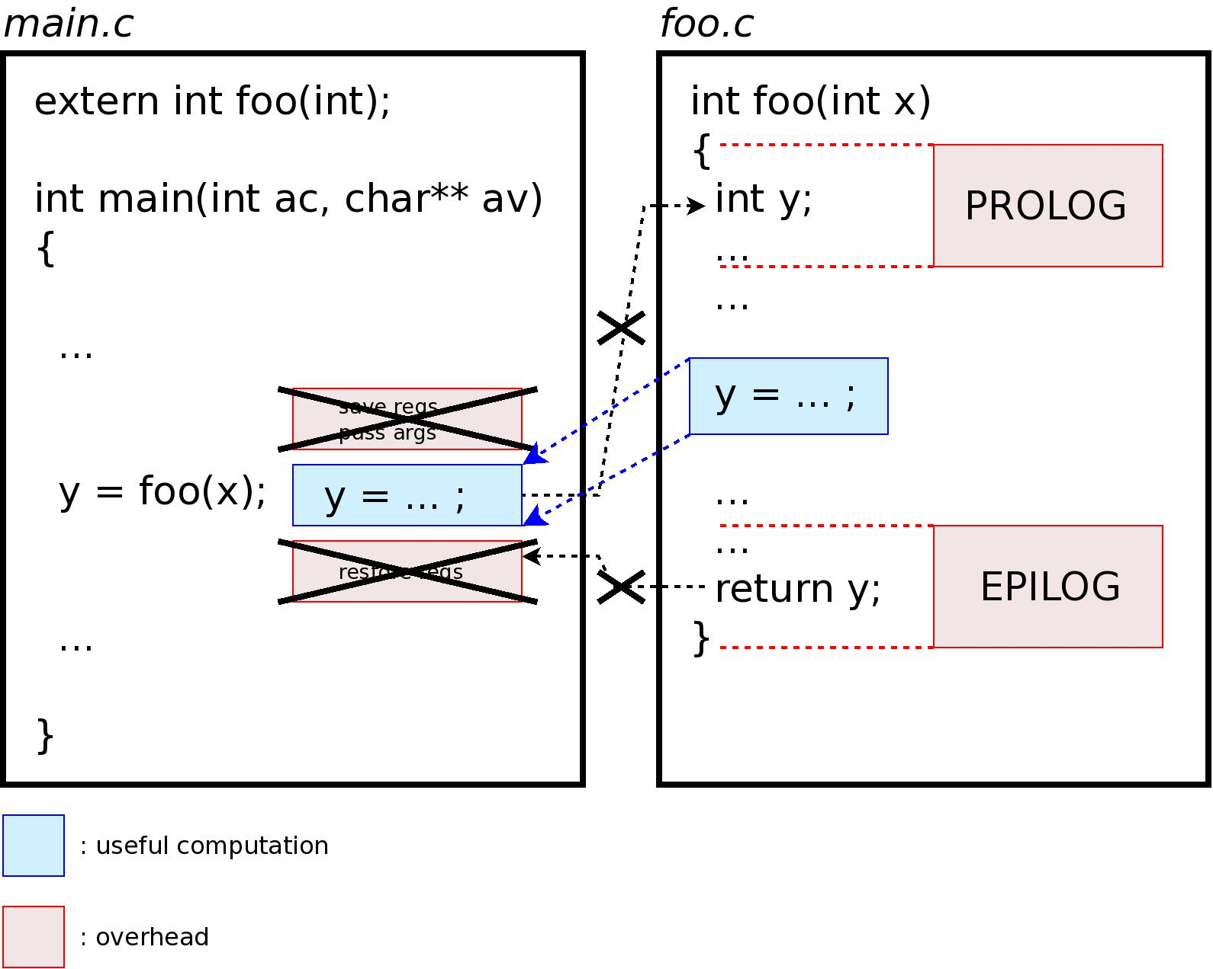
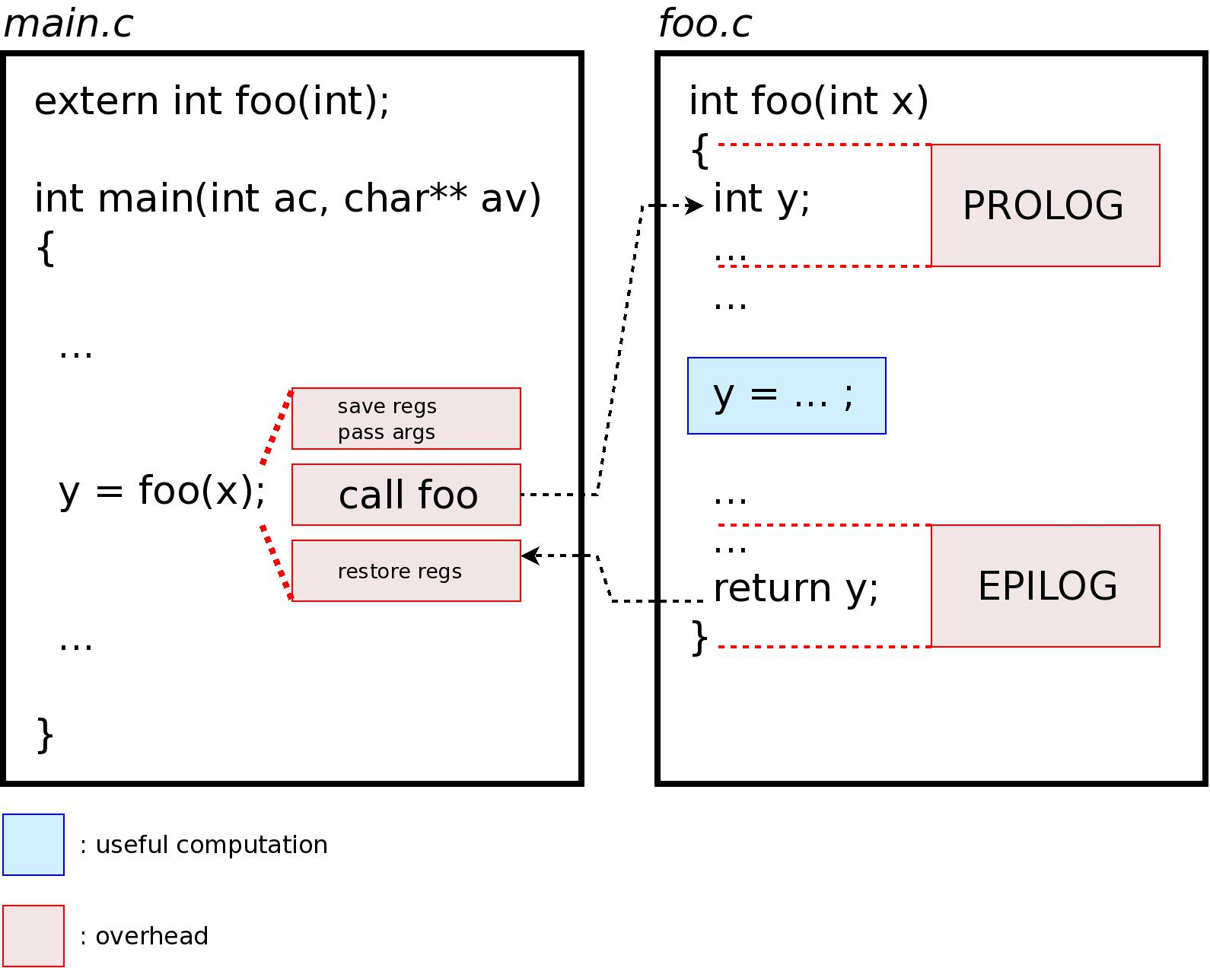
Function Calls
class ArithmaticOperations {
int AddNumbers(int x, int y){
return x + y;
}
int SubtractNumbers (int x, int y) {
return x –y;
}
int MultiplyNumbers (int x, int y) {
return x * y;
}
}
int main() {
int x = 20;
int y = 10;
cout << “Sum of Numbers: “ << AddNumbers(x, y) << endl;
cout << “Difference between Numbers: “ << SubtractNumbers(x, y) << endl;
cout << “Multiplication of numbers: “ << MultiplyNumbers(x, y) << endl;
}
Notes:
https://www.geeksforgeeks.org/inline-functions-cpp/

Slide 88
Inline functions
Compiler may not perform inlining in such circumstances like: 1) If a function contains a loop. (for, while, do-while) 2) If a function contains static variables. 3) If a function is recursive. 4) If a function return type is other than void, and the return statement doesn’t exist in function body. 5) If a function contains switch or goto statement.

Slide 89
Function Calls
class ArithmaticOperations {
int AddNumbers(int x, int y){
return x + y;
}
int SubtractNumbers (int x, int y) {
return x –y;
}
int MultiplyNumbers (int x, int y) {
return x * y;
}
}
int main() {
int x = 20;
int y = 10;
cout << “Sum of Numbers: “ << AddNumbers(x, y) << endl;
cout << “Difference between Numbers: “ << SubtractNumbers(x, y) << endl;
cout << “Multiplication of numbers: “ << MultiplyNumbers(x, y) << endl;
}
Notes:
https://www.geeksforgeeks.org/inline-functions-cpp/

Slide 90
1. Create a class named weather report that holds a daily weather report with
data members day_of_month,hightemp,lowtemp,amount_rain and
amount_snow. The constructor initializes the fields with default values: 99
for day_of_month, 999 for hightemp,-999 for low emp and 0 for
amount_rain and amount_snow. Include a function that prompts the user
and sets values for each field so that you can override the default values.
Write a program that creates a monthly report.
Static member functions,friend class,this pointer,inline code and dynamic
memory allocation :
2. Develop an object oriented program in C++ to create a database of the
personnel information system containing the following information:
Name,Date of Birth,Blood group,Height,Weight,Insurance Policy
number,Contact address,telephone number,driving licence no. etc
Construct the database with suitable member functions for initializing and
destroying the data viz constructor,default constructor,copy
constructor,destructor,static member functions,friend class,this
pointer,inline code and dynamic memory allocation operators-new and
delete.

Slide 91
A book shop maintains the inventory of books that are being sold at the shop. The list
includes details such as author, title, price, publisher and stock position. Whenever a
customer wants a book, the sales person inputs the title and author and the system
searches the list and displays whether it is available or not. If it is not, an appropriate
message is displayed. If it is, then the system displays the book details and requests
for the number of copies required. If the requested copies book details and requests
for the number of copies required. If the requested copies are available, the total cost
of the requested copies is displayed; otherwise the message “Required copies not in
stock” is displayed.
Design a system using a class called books with suitable member functions and
Constructors. Use new operator in constructors to allocate memory space required.
Implement C++ program for the system.

Slide 92
Develop an object oriented program in C++ to create a database of student information system containing the following information: Name, Roll number, Class, division, Date of Birth, Blood group, Contact address, telephone number, driving license no. etc Construct the database with suitable member functions for initializing and destroying the data viz constructor, default constructor, Copy constructor, destructor, static member functions, friend class, this pointer, inline code and dynamic memory allocation operators-new and delete.

Slide 93
Write a C++ program create a calculator for an arithmetic operator (+, -, *, /). The program should take two operands from user and performs the operation on those two operands depending upon the operator entered by user. Use a switch statement to select the operation. Finally, display the result.
Some sample interaction with the program might look like this:
Enter first number, operator, second number: 10 / 3
Answer = 3.333333
Do another (y/n)? y
Enter first number, operator, second number: 12 + 100
Answer = 112
Do another (y/n)? n

Slide 94
Implement a class Quadratic that represents degree two polynomials i.e., polynomials of type ax2+bx+c. The class will require three data members corresponding to a, b and c. Implement the following operations:
1. A constructor (including a default constructor which creates the 0 polynomial).
2. Overloaded operator+ to add two polynomials of degree 2.
3. Overloaded << and >> to print and read polynomials. To do this, you will need to decide what you want your input and output format to look like.
4. A function eval that computes the value of a polynomial for a given value of x.
5. A function that computes the two solutions of the equation ax2+bx+c=0.

Slide 95
Implement a class CppArray which is identical to a one-dimensional C++ array (i.e., the index set is a set of consecutive integers starting at 0) except for the following :
1. It performs range checking.
2. It allows one to be assigned to another array through the use of the assignment operator (e.g. cp1= cp2)
3. It supports a function that returns the size of the array.
4. It allows the reading or printing of array through the use of cout and cin.

